Slide 1
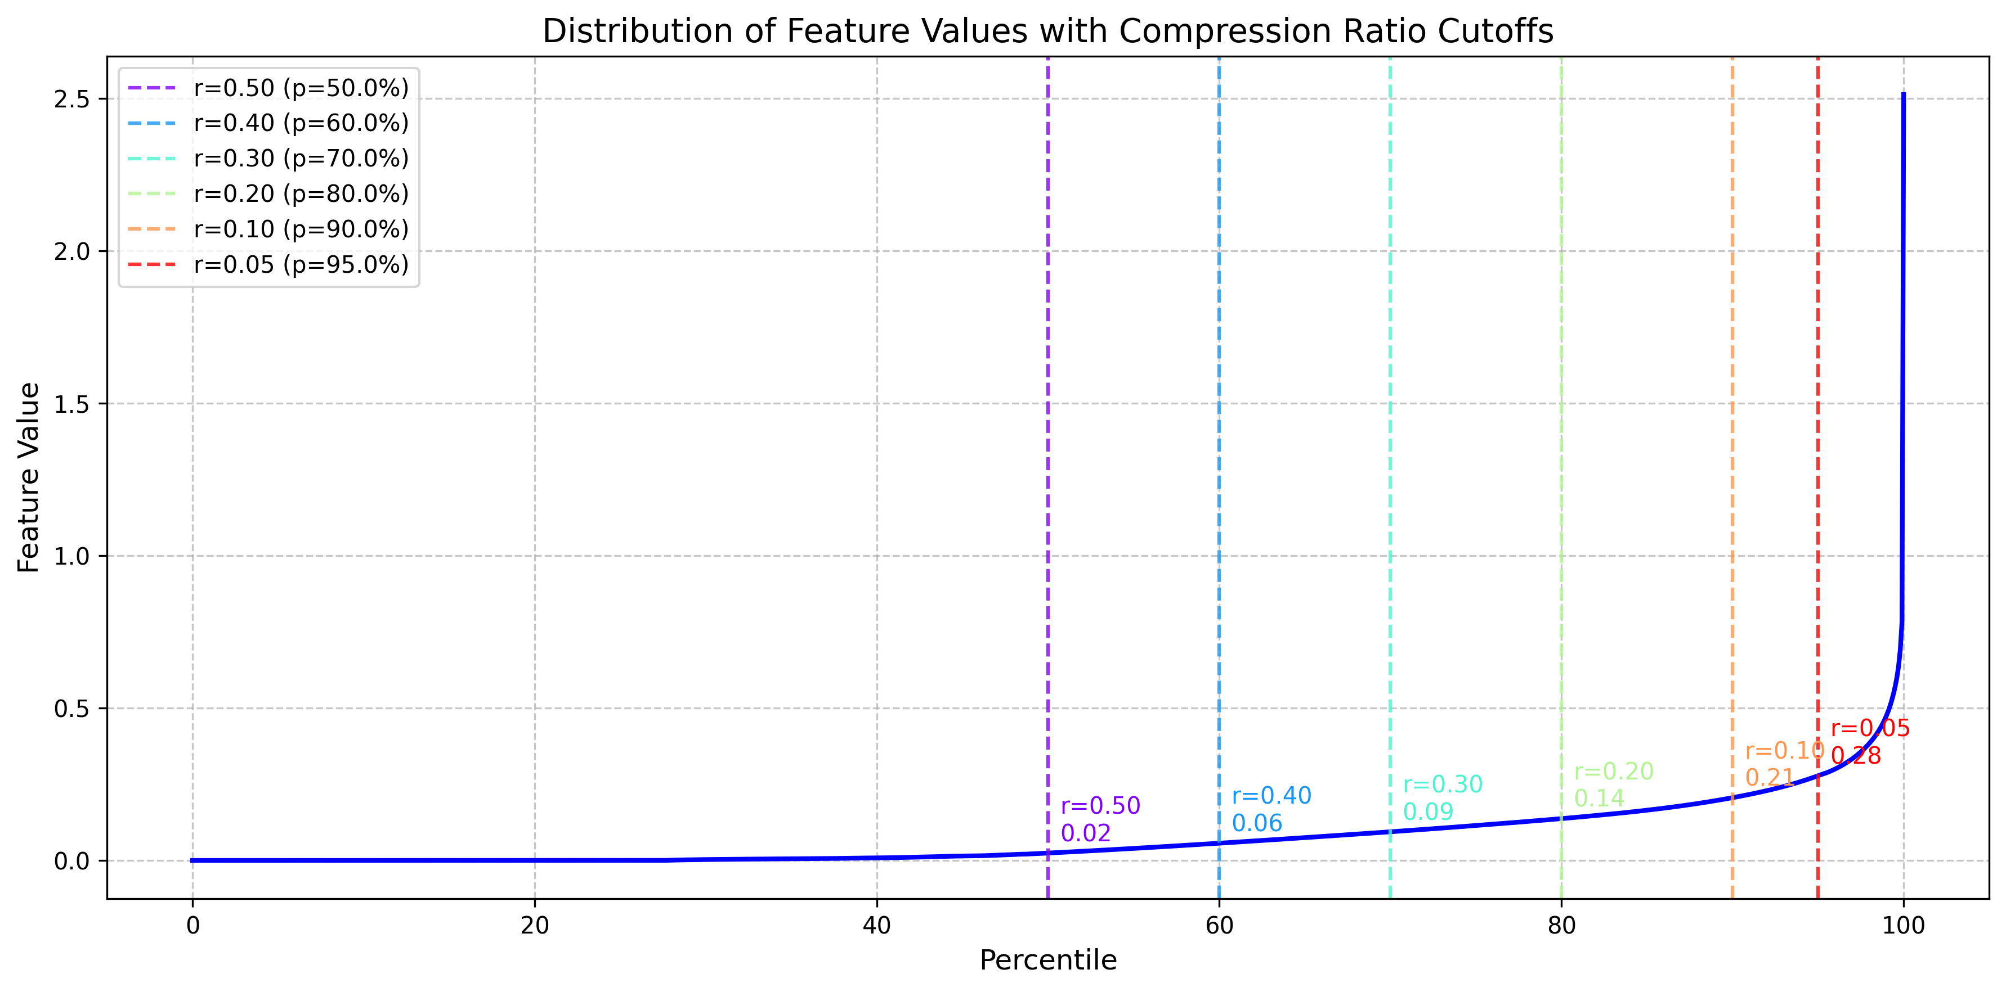
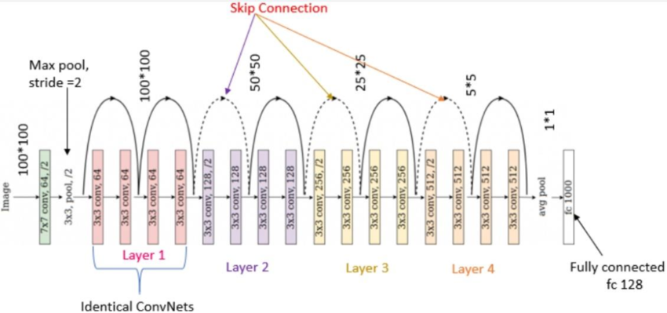

Slide 3
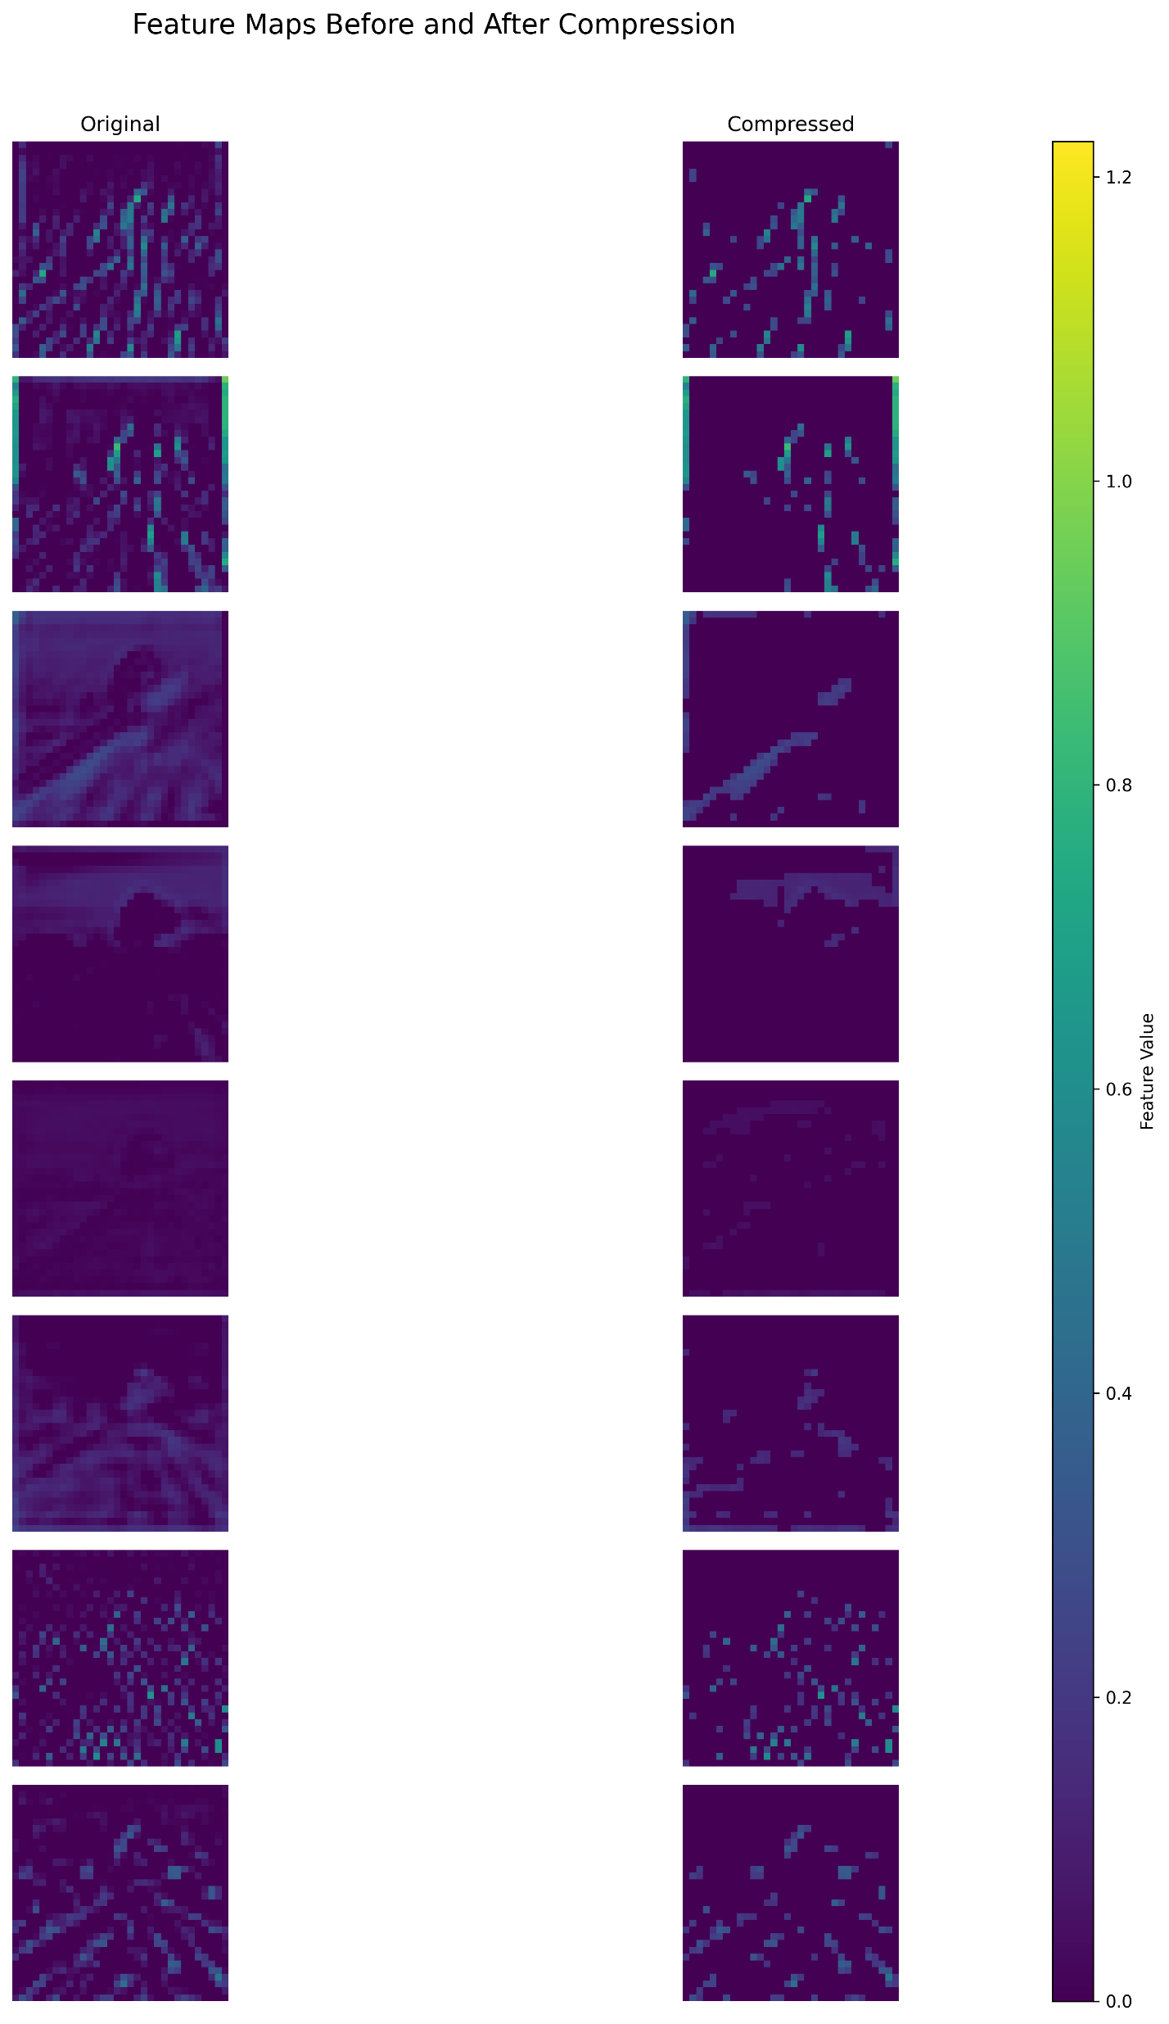
Features are sparse
Sparse representation to represent the larger feature values
Top K method to select the important features
Fine tuning of remaining layers

Slide 6
Channel Wise TopK or not
Fine tuning
Actual bpp
Not all high value ones are important, most may be redundant

